Slide 1
Group 5: Vision-based Navigation of a Mobile Robot.

Slide 2
Group Members.
Machio Festus Brian E022-01-1070/2018
Janet Chepkirui E022-01-1753/2017
Mathenge King’au E022-01-1838/2018
Fred Mutegi E022-01-1054/2018
Brian Gacheru E022-01-1060/2018

Slide 3
Introduction.
This presentation describes a vision-based navigation method in an indoor environment for an autonomous mobile robot which can avert impediments.
Vision, plays a major role in the implementation of diversified navigation to provide solutions for different scenarios.

Slide 4
Problem Statement.
The fact that both self-localization and obstacle avoidance are accomplished by processing the same image is particularly remarkable, since it eliminates what would otherwise be a redundancy in sensor data collecting.
Aims at solving novel challenges that exist in the development of a control system that enables a mobile robot navigate while perceiving its environment.
The main challenge within a visual-search process is that the environmental conditions are difficult to control, because the search robot executes its tasks in dynamic environments in addition to the challenges of scaling these small robots up to useful industrial capabilities.

Slide 5
Objectives of the Project.
To come up with a 3D model of the mobile robot.
To design the electrical schematic of the mobile robot.
To program and simulate the mobile robot control.
Testing and demonstrating the navigation capability of the robot

Slide 6
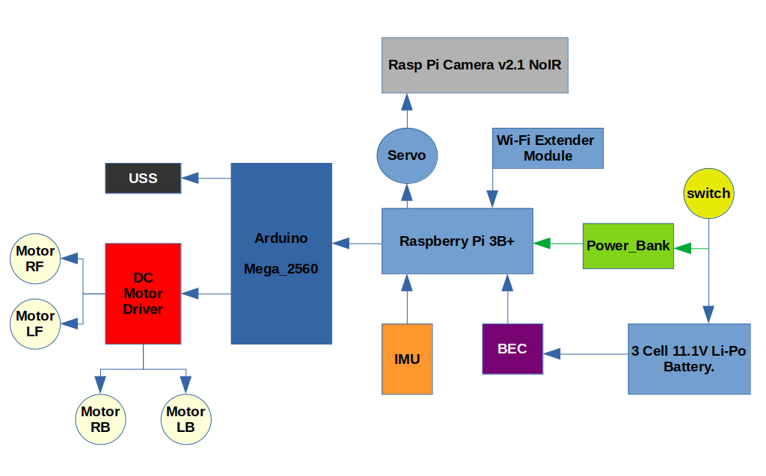
Electrical Components and Connection.

Slide 7
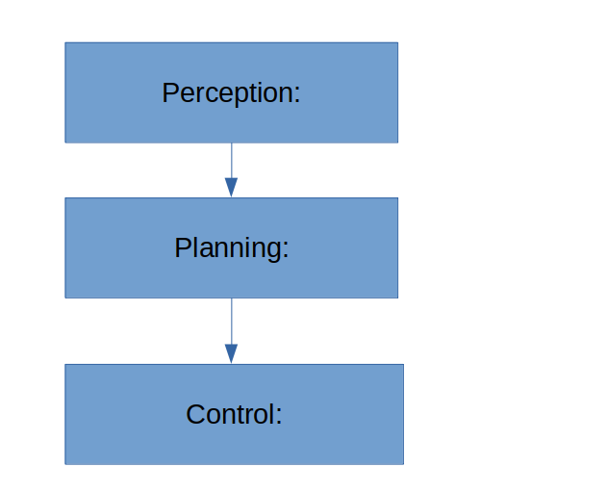
Working Principle(s).

Slide 8
Program/Logic Flowchart.
/home/braen/Desktop/Docs/Final Year/1st Semester/Project/Vision AGV/Presentation_1.pdf
(Ctrl+Click)
link

Slide 9
Project Milestone/Deliverable. Mechanical Concept.
/home/braen/Desktop/Docs/Final Year/1st Semester/Project/Vision AGV/Navigation Video.mp4
(Ctrl+Click)
link

